Slide 1
Pivotal Cloud Foundry
Dominic Tippabattuni

Slide 2
Contents
Introduction
PCF Services
PCF Architecture
Demo – Command Line Utility and Application Manager
Articulate – Reference Application
Services
Scaling and HA

Slide 3
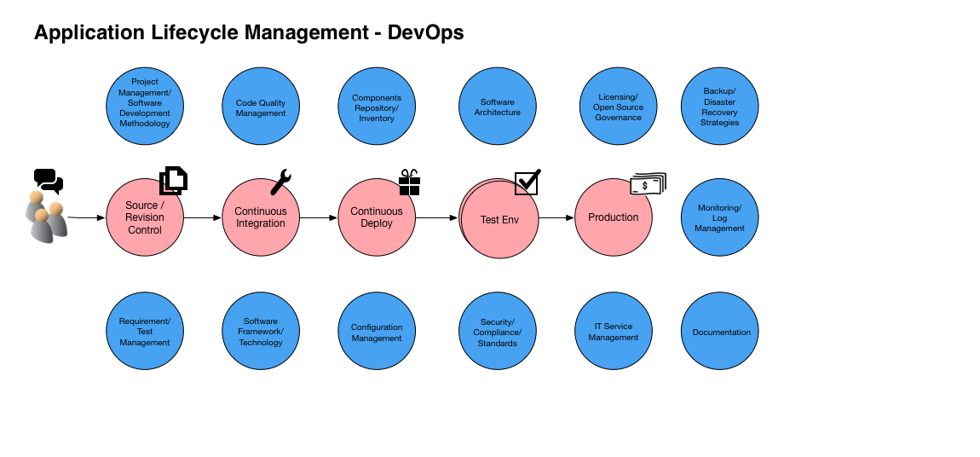
Introduction

Slide 4
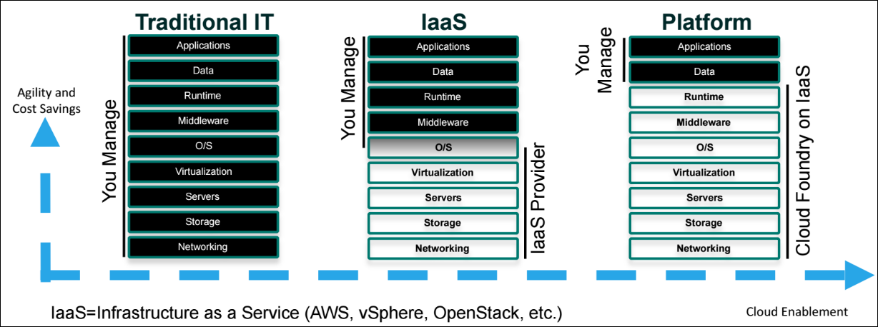
PCF – Platform-as-a-Service
Cloud Foundry Certified Provider
Facilitates 12-Factor Application development

Slide 5
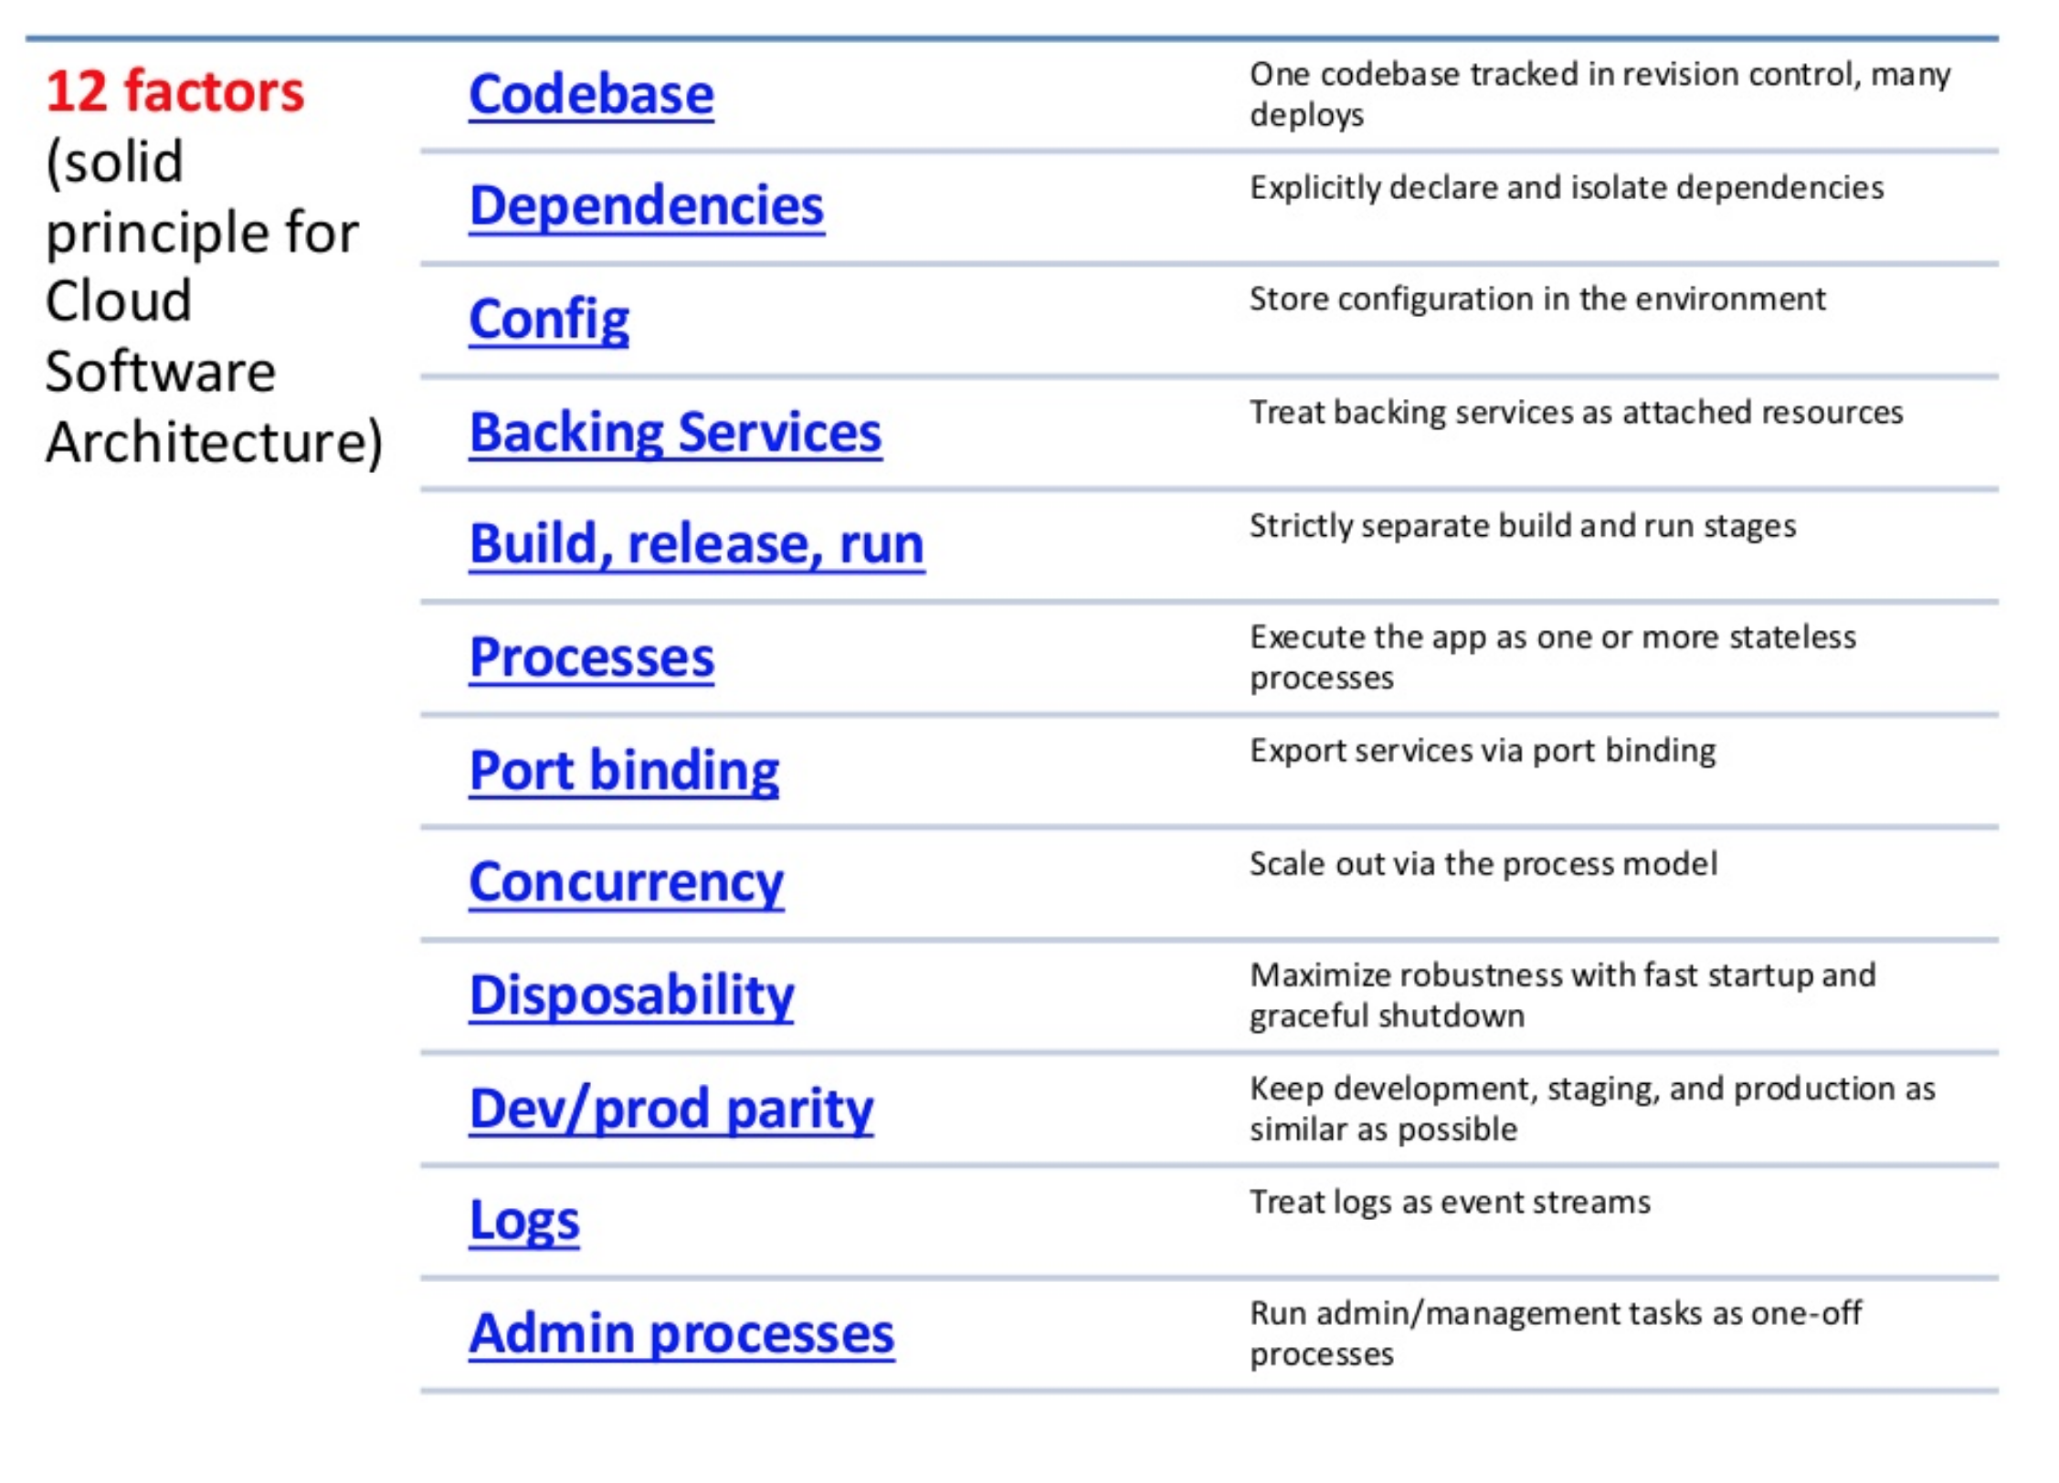
12 Factors

Slide 6
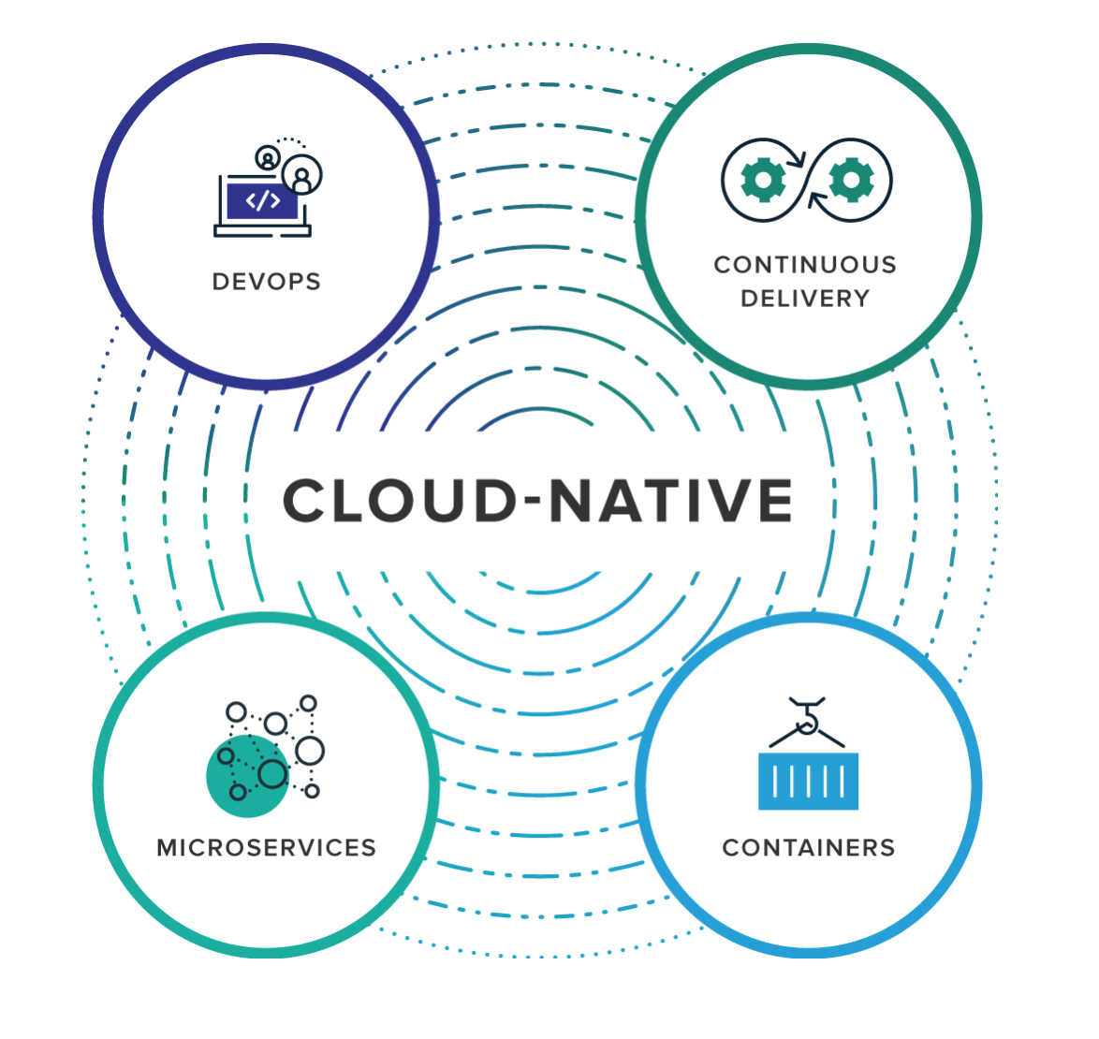
Pivotal Cloud Foundry – Core Tenets
Self-serve platform for developers.
Operationally Robust
IaaS Independent

Slide 7
Cloud-Native vs Traditional Appications
Cloud-Native Application | Traditional Application
Predictable | Unpredictable
OS Abstraction | OS Dependent
Independent | Over-sized Capacity
Collaborative | Siloed
Automated Scaling | Manual Scaling
Continuous Delivery | Waterfall Development

Slide 8
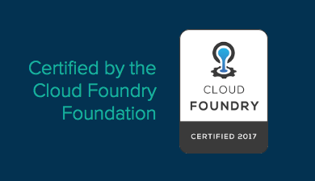
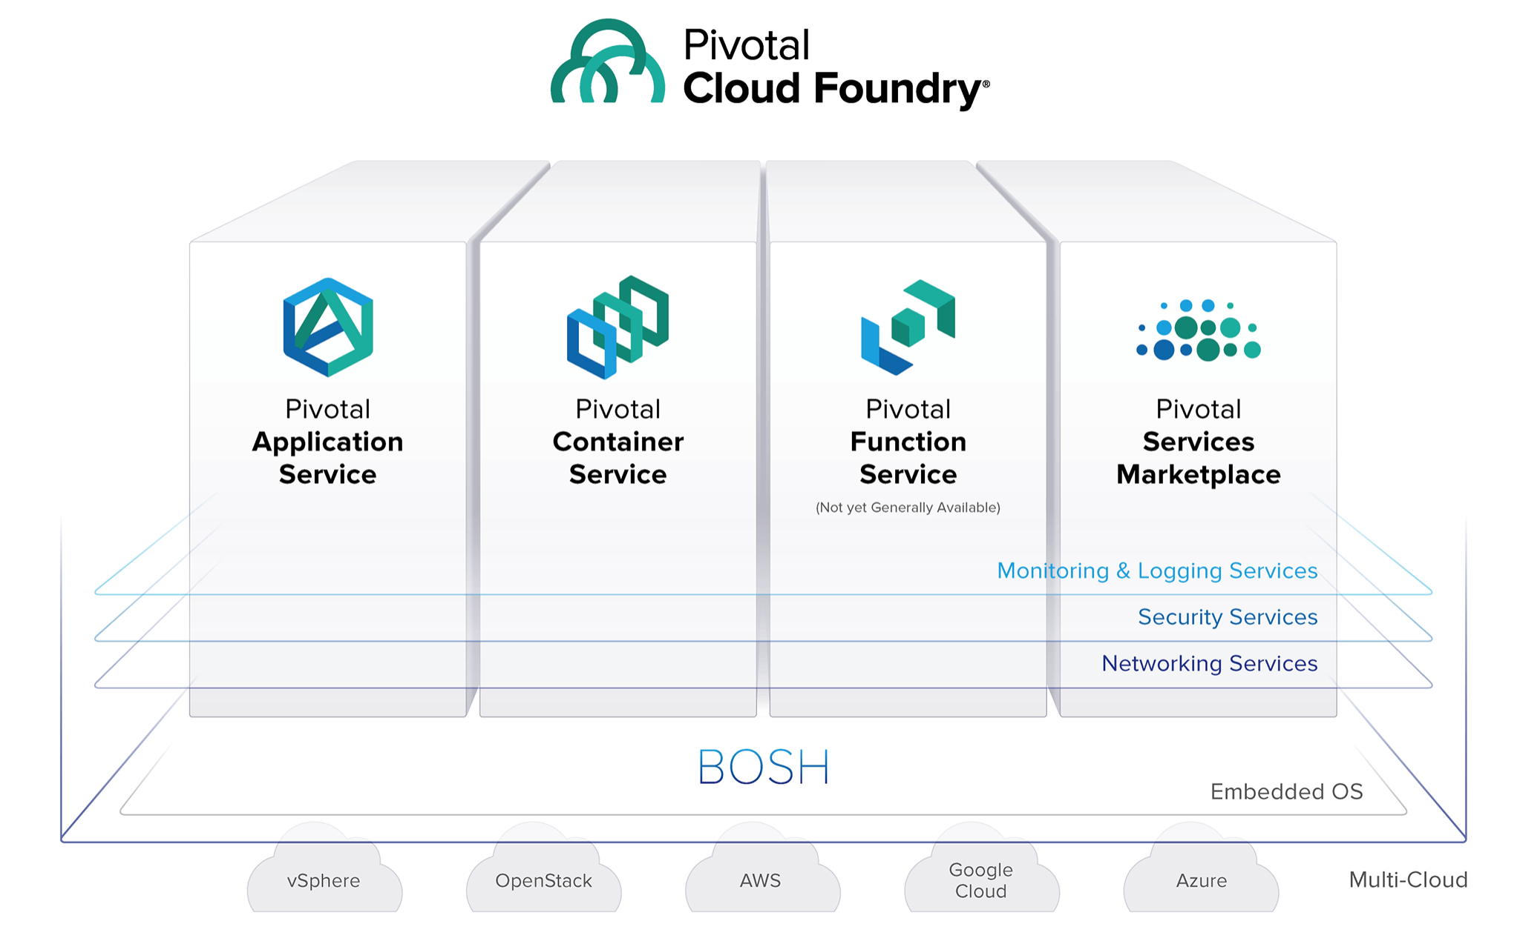
PCF Services

Slide 9
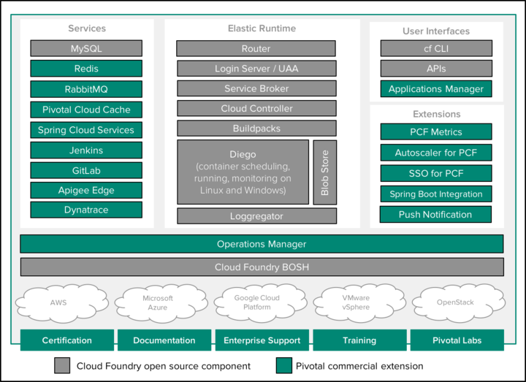
PCF Architecture

Slide 10
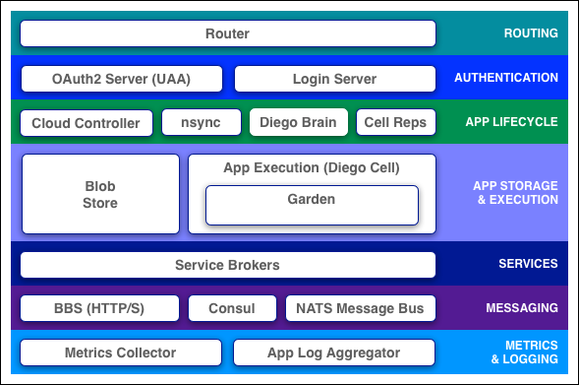
Component: Elastic Runtime

Slide 11
Component: GoRouter
Routes traffic to appropriate component ( control or application calls )
Periodically queries the Diego Bulletin Board System (BBS) to update routes

Slide 12
Component: Cloud-Controller
Provides REST endpoint for clients to access the system.
Maintains the database for org, spaces, services, user roles and more.
Interacts with
Diego Auction
Database (CC_DB)
Blobstore

Slide 13

Demo – PCF User Interfaces
PCF Applications Manager
CF CLI
https://console.run.pivotal.io/

Slide 14
PCF - Applications Manager - Basics
Org
Spaces
Domains
Routes

Slide 15
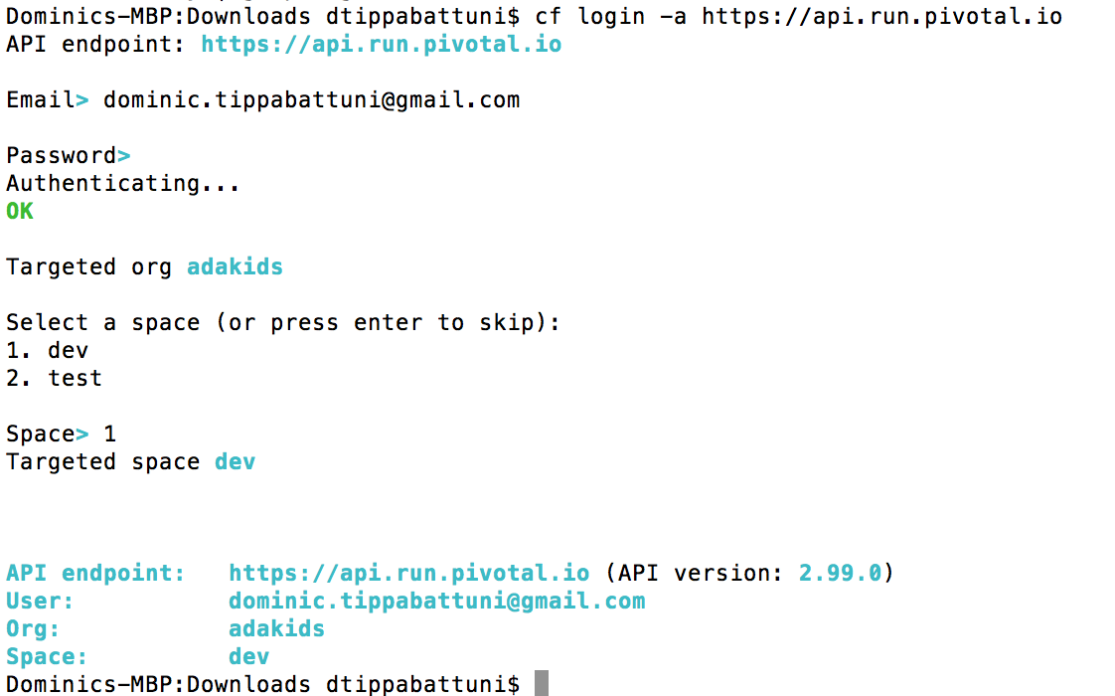
cf login

Slide 16
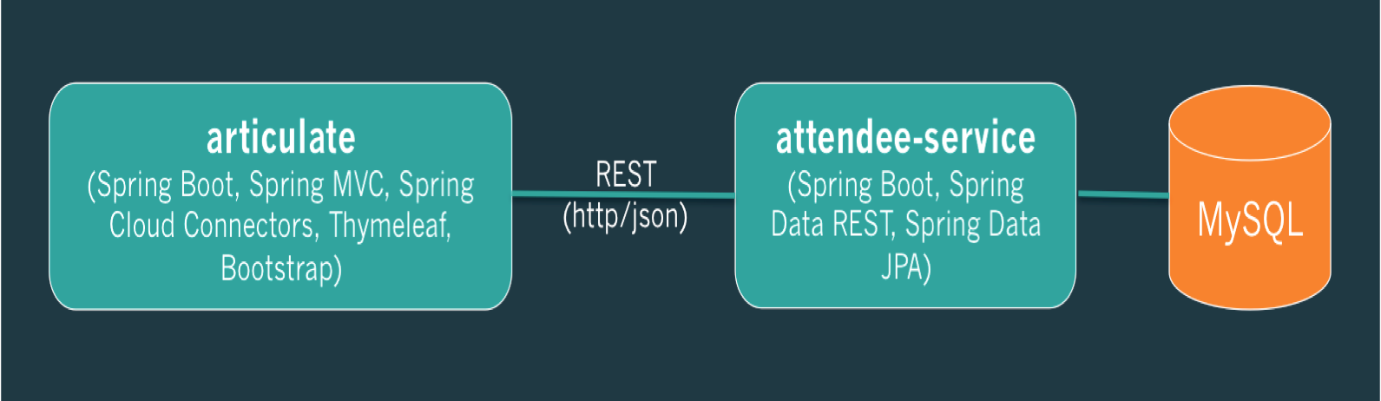
Reference Application Deployment

Slide 17
Step 1: Create DB Service
Service Name: attendee-mysql

Slide 18
Step 2: Deploy attendee-service – cf push
“here is my source code run it on the cloud for me i do not care how”

Slide 19
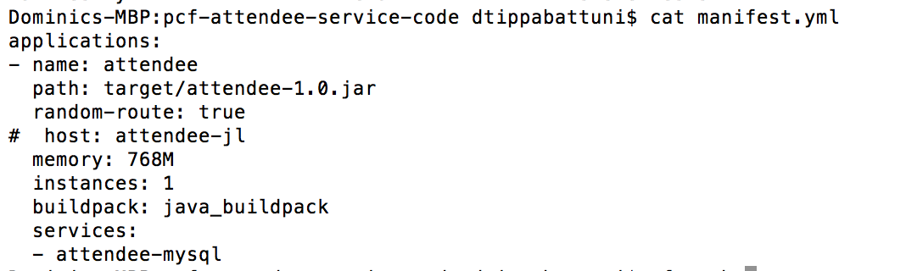
manifest.yml
Provides consistency and reproducibility
Helps automate deploying apps

Slide 20
cf push – overview

Slide 21
cf push – Staging Sequence

Slide 22
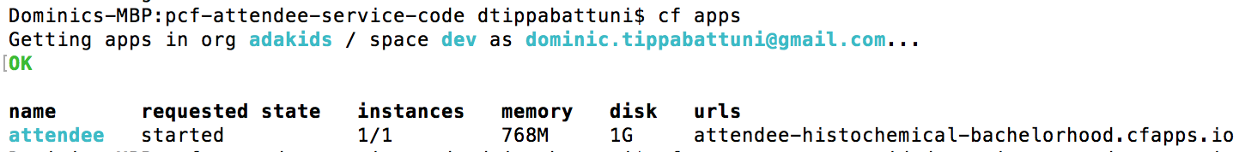
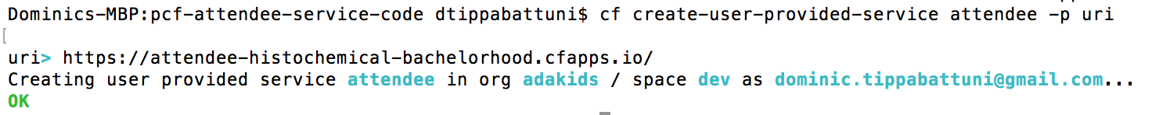
Step 3: cf create-user-provided-service
cf apps
cf create-user-provided-service, cups

Slide 23
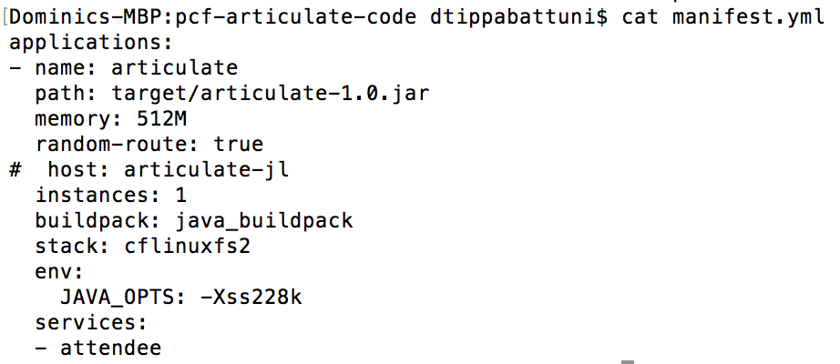
Step 4: Deploy articulate app – cf push

Slide 24
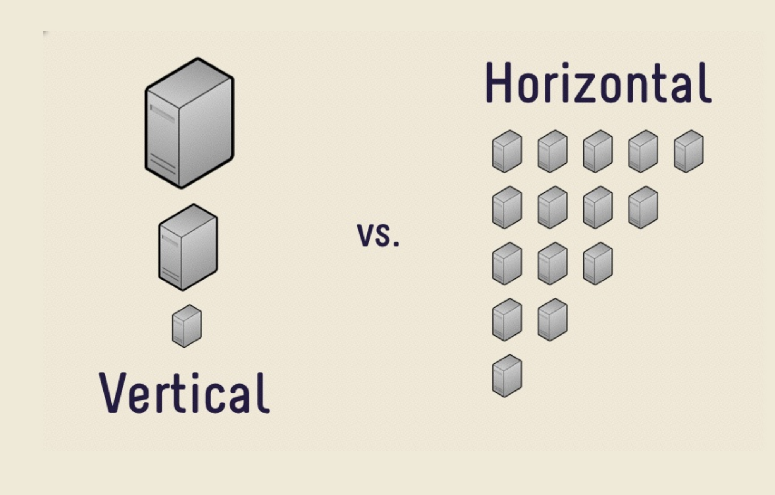
Demo: Scaling – cf scale

Slide 25
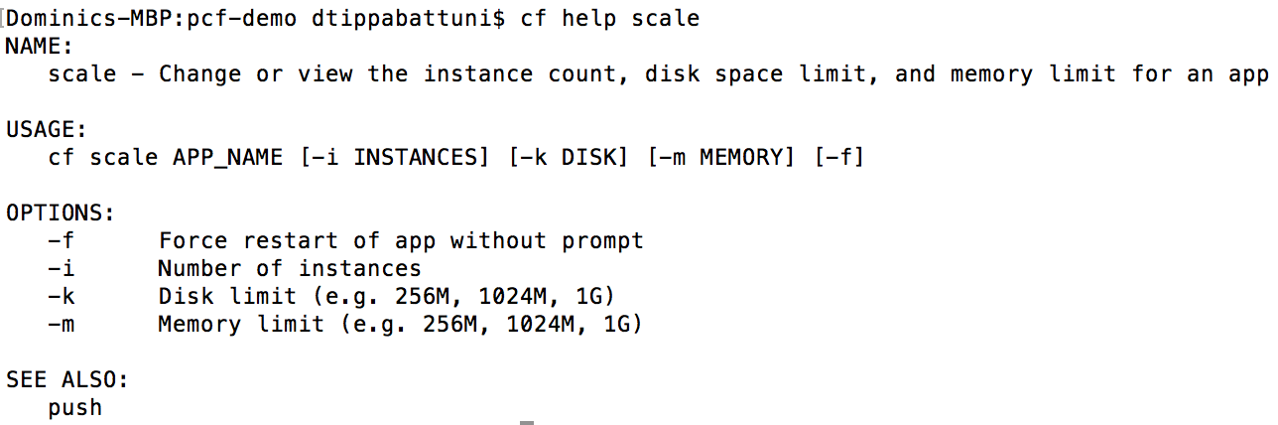
Demo: Scaling – cf scale

Slide 26
Thank You!

